Slide 1

Startup and Entrepreneurial Activity Presentation
on
FarmEquip Rent (Farmer Equipment Rental)
By
Group Number :- 01
Submitted By :- Submitted To :-
Abhi Jaiswal(2200140100006) Ms.Prity Bala
Junaid Khan(2200140100044) ()
Srishty Jain(2300140109008)
Tanisha Sharma(2200140100108)

Slide 2
INTRODUCTION
Farmers play a vital role in ensuring food security, but many still struggle with limited resources and outdated methods.
Purchasing equipment like tractors, harvesters, or seeders requires high investment, which is often unaffordable for small and marginal farmers.
This leads to low productivity, high dependence on manual labor, and reduced profitability.
A Farmer Equipment Rental Startup aims to bridge this gap by offering agricultural machinery on rent at affordable prices.
The service will be supported by a digital platform (mobile app / website ) for easy booking, tracking, and usage.
Along with improving efficiency, the model also creates rural employment opportunities through operators, mechanics, and logistics support.

Slide 3
OBJECTIVE
To provide affordable access to modern agricultural equipment for farmers who cannot purchase costly machinery.
To increase productivity and reduce labor-intensive farming practices through rental solutions.
To create a digital platform (app/website) for easy booking, tracking, and renting of farm equipment.
To ensure timely availability of machines during critical agricultural seasons.
To empower small and marginal farmers by reducing financial burden and promoting sustainable farming practices.
To generate employment opportunities for operators, mechanics, and logistics providers.

Slide 4
PROBLEM STATEMENT
A large number of small and marginal farmers cannot afford to purchase costly agricultural machinery.
Lack of access to modern equipment leads to low productivity, delayed operations, and higher labor costs.
Farming is often dependent on manual labor, which is becoming scarce and expensive.
During peak seasons (sowing, harvesting), farmers face shortage and unavailability of machines on time.
These challenges result in reduced crop yield, financial losses, and lower profitability for farmers.

Slide 5
PROPOSED SOLUTION
Establish a Farmer Equipment Rental Service to provide modern agricultural machinery on affordable rent.
Develop a digital platform (mobile app/website) where farmers can:
  Browse available equipment.
  Book rentals instantly.
  Track usage and payments.
Ensure timely delivery of equipment to farms through a logistics and operator support system.
Partner with equipment owners, dealers, and farmer groups to increase machine availability.
Create a subscription/membership model for frequent users with discounted rates.

Slide 6
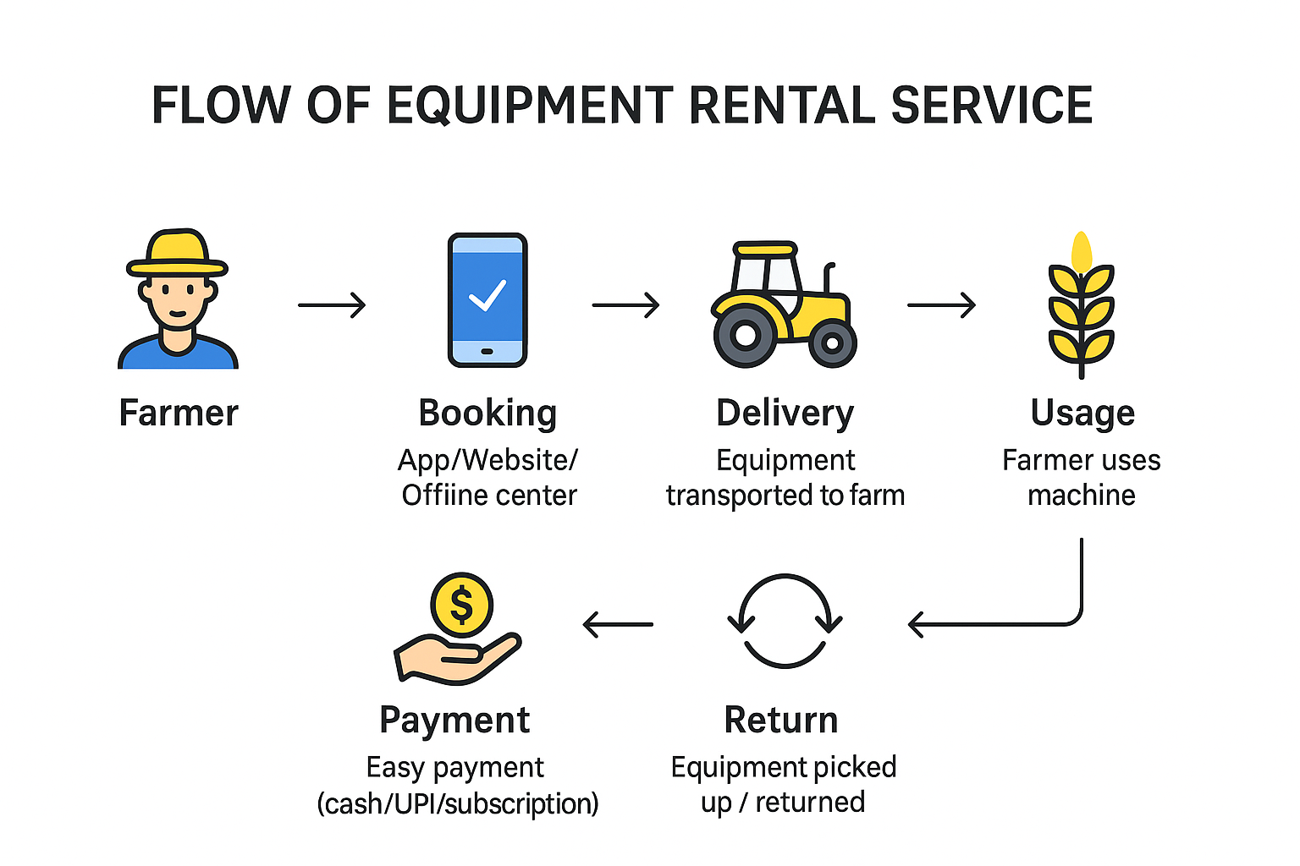
FLOW CHART

Slide 7
FEATURES
Wide range of equipment – tractors, harvesters, tillers, sprayers, and more on rent.
Affordable rentals – cost-effective pricing designed for small & marginal farmers.
Easy booking – available through mobile app, website, and offline centers.
Flexible payment options – UPI, and subscription/membership packages.
Timely availability – machines provided during critical sowing & harvesting periods.
Future expansion – crop advisory, weather alerts, and partnerships with agri-input suppliers.

Slide 8
BUSINESS MODEL
Rental Charges :-
  Farmers pay on an hourly, daily, or seasonal basis depending on equipment usage.
Subscription / Membership Plans :-
  Frequent users can take monthly or yearly packages at discounted rates.
Commission-Based Model :-
  Partner with equipment owners/dealers; charge a commission fee on every booking.
Add-On Services (future scope)
  Crop advisory, weather updates, soil testing, and tie-ups with seed/fertilizer companies for extra revenue.

Slide 9
IMPACT OF THE STARTUP
Affordable Farming – Reduced cost of cultivation by eliminating the need to buy expensive machinery.
Higher Productivity – Timely availability of equipment increases efficiency and crop yield.
Support for Small Farmers – Empowers small and marginal farmers to access modern technology.
Employment Generation – Creates jobs for operators, mechanics, and logistics providers.
Rural Development – Improves income opportunities and promotes sustainable farming practices.
Optimal Utilization of Machinery – Ensures machines are used efficiently instead of lying idle.
Scalability – Model can be expanded to multiple districts and states, creating large-scale social and economic benefits.

Slide 10
CONCLUSION
Farming in India is facing challenges due to high cost of machinery, low productivity, and limited resources for small and marginal farmers.
The proposed Farmer Equipment Rental Service offers an affordable, accessible, and sustainable solution by providing modern equipment on rent.
With a digital booking platform, logistics support, and trained operators, farmers can get timely access to machines without heavy investments.
This startup will not only improve agricultural productivity but also generate employment opportunities and contribute to rural development.
In the long run, the model has the potential to scale across regions, transforming agriculture into a more efficient, profitable, and inclusive sector.

